Slide 1
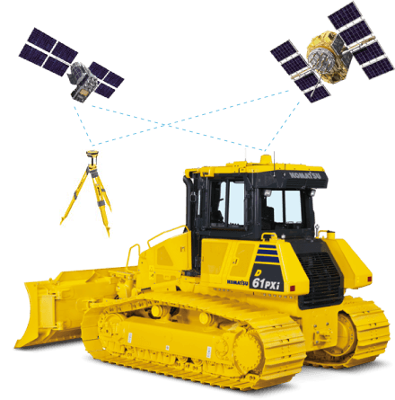
Importing Files to Komatsu IMC dozer

Slide 2
Important Information
Files need to be located on the root folder of the thumb drive being used to load files – files cannot be in a folder
Project File Format - .tp3 (TIN, Linework, Localization)
Surface File Format - .tn3 (TIN file)
Linework File Format - .ln3 (Linework file)
Localization File Format - .gc3 (Control)

Slide 3
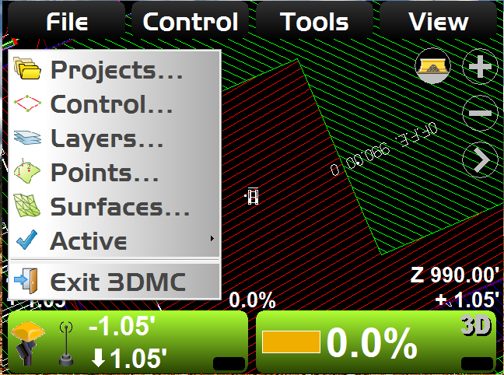
Hit File Button and Select Projects

Slide 4
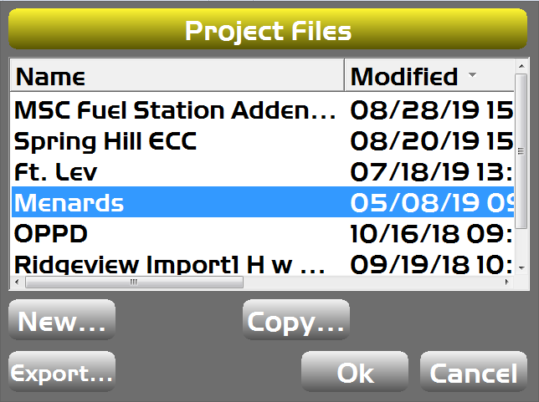
Hit the Copy Button

Slide 5
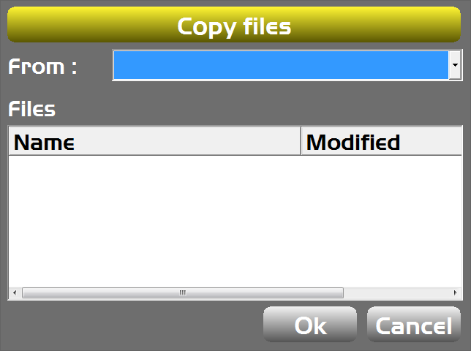
From: USB to 3DMC then highlight file you want to copy

Slide 6
Select the New Project File – then hit OK

Slide 7
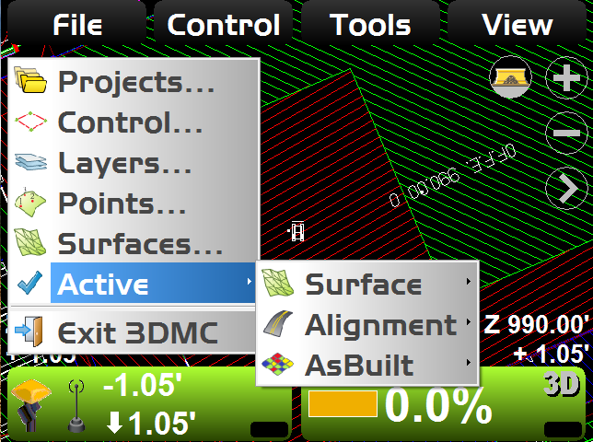
Set an Active Surface

Slide 8
Loading TIN (.tn3) File
If only the surface (finish grade) of the project changes, you can load a new .tn3 file.
This will keep all the other project information (linework, calibration, etc) the same
You will now be able to select the newly loaded surface as the active surface
The original surface file will remain part of the project file
.tn3 file needs to be on the root drive of a thumb drive

Slide 9
Go to File and Select Surfaces

Slide 10
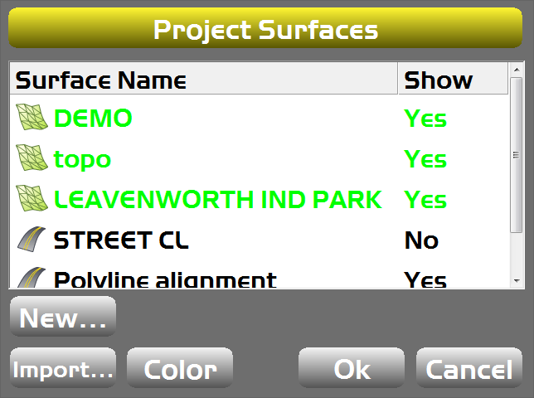
Hit Import to Add New Surface File

Slide 11
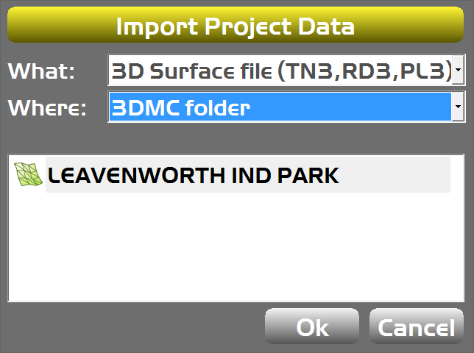
File must be stored in 3DMC folder

Slide 12
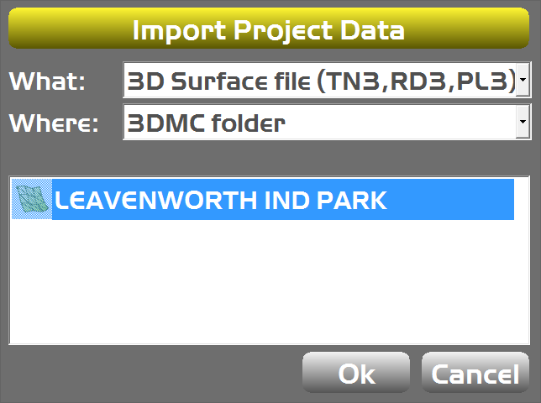
Highlight Surface to Import

Slide 13
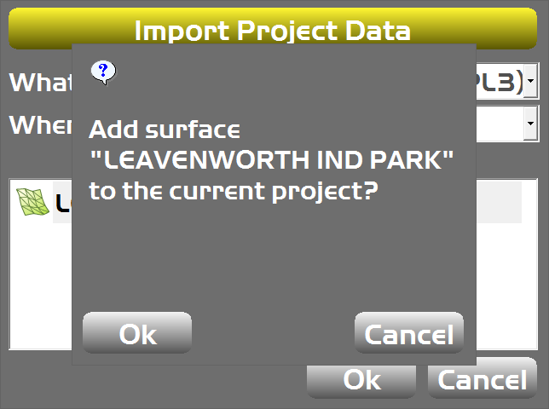
Add New Surface to Current Project

Slide 14
Set New Surface as Active Surface

